Slide 1
GCBASIC
PIC16fF175xx
Part 19 - Assembly , alternatives assemblers and Debugging

Slide 2

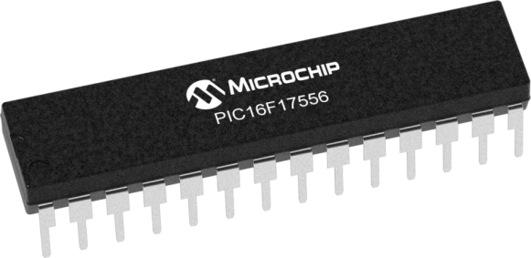
GCBASIC
PIC16fF175xx
Part 19 - Assembly , alternatives assemblers and Debugging

Slide 3
GCBASIC
Like and subscribe!

Slide 4
PIC16F175xx
PIC16175xx is a high performance PIC16
Digital and analog peripherals for flexible embedded control
10-bit ADC for accurate analog signal conversion
Multiple communication interfaces including UART (serial), I²C, and SPI
PWM modules with CCP and 16-bit resolution for precise timing and motor control
Configurable Logic Cells (CLCs) for custom hardware-level logic without external components
Integrated op amps for onboard analog signal conditioning and amplification
The PIC16175xx offers 14, 20, 28, 40 and 44-pin products in small footprint packages to support customers in a wide variety of applications.

Slide 5
Videos...
Install the hardware and make the board work – three LED programs
Make four LEDs flash in a sequence
Set the LEDs to represent the value of ADC
Sequence the LEDs with a delay using the value of ADC
Using an input to set the state of the LEDs
Using the reset switch
Using the switch, ADC – make the LEDs flash in a sequence with reverse
Using the serial to display values
Using the timer0 overflow, 8bit timer, 16bit timer to flash the LEDs
Using EEProm – showing values on the serial terminal, and more constants insights
Using I2C with serial to discover I2C devices
Using I2C GCLD display solutions
Using a SPI GLCD display solutions
Using PWM, 6 ways, to dim the LEDS
Using an external interrupt to control an LED
Using storage within the chip
Using CLC
The GCBASIC tool chain
Assembly , alternatives assemblers and Debugging
Summary

Slide 6
GCBASIC Compiler
GCBASIC Compiler
GCBASIC is an Open Source compiler for PIC, AVR and LGT microcontrollers
GCBASIC now supports the 16fF175xx chip family
GCBASIC is a cross platform with common code translation

Slide 7
GCBASIC Compiler
GCBASIC Compiler
GCBASIC is an Open Source compiler for PIC, AVR and LGT microcontrollers
GCBASIC now supports the 16fF175xx chip family
GCBASIC is a cross platform with common code translation

Slide 8
The core compiler
High Level Language
Reports:
TXT and HTML
Source Code
GCBASIC Compiler
GCBASIC Compiler
Preprocessor
Code Translator
Assembler
Linker
Assembly Language
ASM file
Absolute Machine Code
HEX file
Libraries
8 bit PIC, AVR, AVR-DX and LGT

Slide 9
Compiler options
High Level Language
Reports:
TXT and HTML
Source Code
PIC-AS, MPASM,
MPLAB-IDE,
GPASM, AVRASM2
GCBASIC Compiler
GCBASIC Compiler
Preprocessor
Code Translator
Assembler
Linker
Assembly Language
file
Absolute Machine Code
HEX file
Libraries
8 bit PIC, AVR, AVR-DX and LGT

Slide 10
Lab – Pre 2026
We will
Review the simple LED program
Change to PIC-AS in Prefs Editor
Create a Project in MPLAB-X using the GCBASIC .S as the source
Select Standalone project
Specify chip, select the Simulator
Select PIC-AS, latest version
Name project {chipname}, specify same directory.
Finish
Now, add the GCBASIC source file
Add existing item/select source .S file with AUTO
Select File/Project Properties
Set Conf:[default] Simulator / Instruction Frequency to 64
Set Conf:[default] Building / Check Execute this line after build
C:\GCSTUDIO\PICKitPlus\pickitcommandline.exe -w -p${Device} -f${ImagePath} -mpec -zv -a5
Press OK to save
Test compile <F11> and program
Use the debugger to walk the code

Slide 11
Lab – Post 2025
We will
Review the simple LED program
Start the GC Code PIC Debugger
Select the debugger tool or the simulator
Use the debugger to walk the code
Source Code
Variables
Registers

Slide 13
Videos...
Install the hardware and make the board work – three LED programs
Make four LEDs flash in a sequence
Set the LEDs to represent the value of ADC
Sequence the LEDs with a delay using the value of ADC
Using an input to set the state of the LEDs
Using the reset switch
Using the switch, ADC – make the LEDs flash in a sequence with reverse
Using the serial to display values
Using the timer0 overflow, 8bit timer, 16bit timer to flash the LEDs
Using EEProm – showing values on the serial terminal, and more constants insights
Using I2C with serial to discover I2C devices
Using I2C GCLD display solutions
Using a SPI GLCD display solutions
Using PWM, 6 ways, to dim the LEDS
Using an external interrupt to control an LED
Using storage within the chip
Using CLC
The GCBASIC tool chain
Assembly , alternatives assemblers and Debugging
Summary

Slide 14
GCBASIC
PIC16fF175xx
Part 19 - Assembly , alternatives assemblers and MPLAB-X

